Slide 1
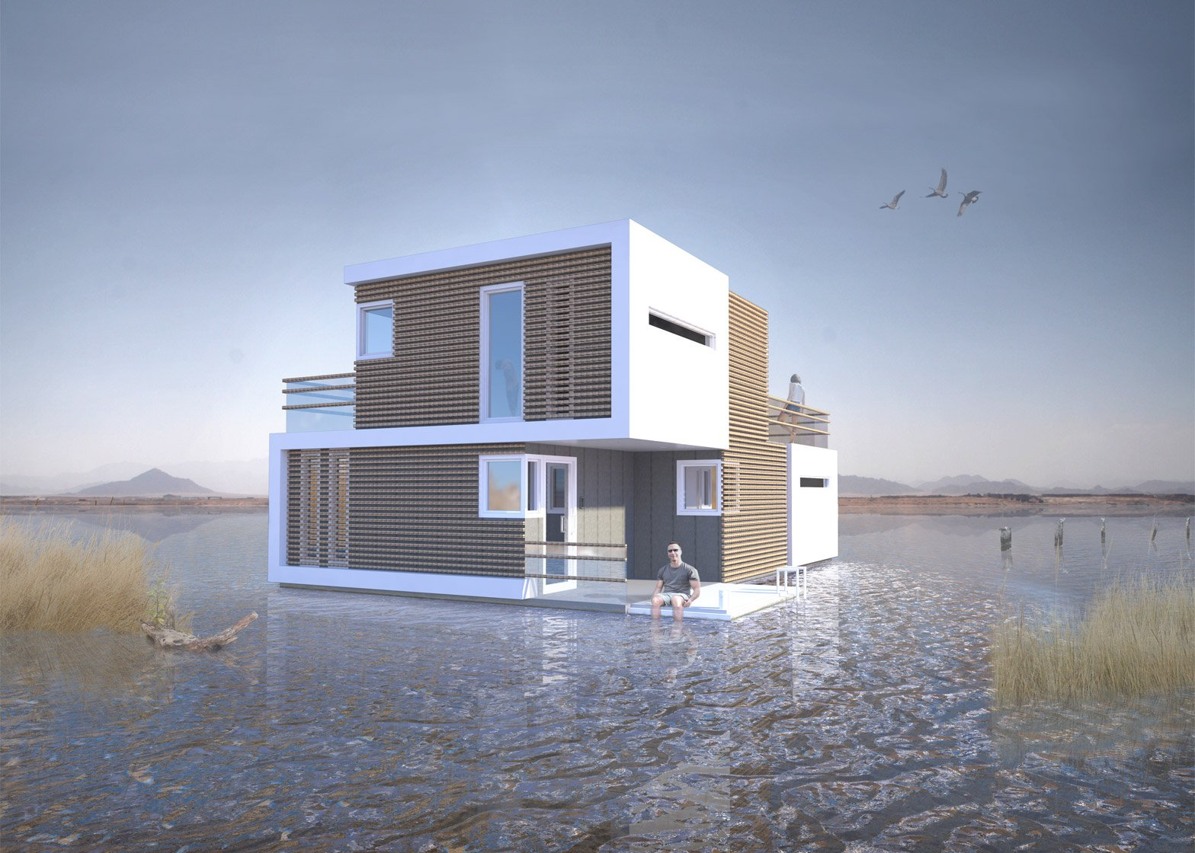
Project Housing splitted
Flip Robo technologies
Prepend By: -
Kishan Sapariya
SME
Khushboo Garg

Slide 2

Problem Statement
Houses are one of the necessary need of each and every person around the globe and therefore housing and real estate market is one of the markets which is one of the major contributors in the world’s economy.
It is a very large market and there are various companies working in the domain.
Data science comes as a very important tool to solve problems in the domain to help the companies increase their overall revenue, profits, improving their marketing strategies and focusing on changing trends in house sales and purchases.
Predictive modelling, Market mix modelling, recommendation systems are some of the machine learning techniques used for achieving the business goals for housing companies.
Our problem is related to one such housing company.
A US-based housing company named Surprise Housing has decided to enter the Australian market. The company uses data analytics to purchase houses at a price below their actual values and flip them at a higher price.

Slide 3

Business Goal
We are required to model the price of houses with the available independent variables. This model will then be used by the management to understand how exactly the prices vary with the variables. They can accordingly manipulate the strategy of the firm and concentrate on areas that will yield high returns. Further, the model will be a good way for the management to understand the pricing dynamics of a new market.

Slide 4

Analysis of Data
For analyse date we use Jupyter Notebook and many libraries such and Pandas, Numpy, for load data and fill data.
For visualization part we use Seaborn and Matplotlib for plot chart and visualize it.
When we observe data then we fill there are many null values in the data for remove the null value and fill the null value we use mode median and mode. It is depend upon the type of data.
We drop many columns which contains many null values above 500.
Rest of the columns are contain less than 100 null values we filled it.

Slide 5
Analysis of Data
By apply mean, mode and median we observe data once again and check it there are null values are there or not then we realize there are no null value.
Now we start our analysis on data.
For analysis we first plot count plot and write some observation of it.

Slide 6
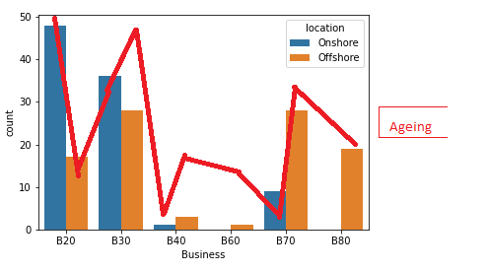
Count plot observation i) object data II)Numerical Data

Slide 7
Object Data
1. MSZoning in this column majority are Residential Low Density.
2. street in this column majority means most of are in paved.
3. Lotshape in this column majority are in Regular.
4. LandContour in this column majority are in Near Flat/Level.
5. LotConfig in this column majority are in Inside lot.
6. LandSlope in this column majority are in Gentle slope.
7. Condition 1 in this column majority are in Normal.
8. Condition 2 in this column majority are in Normal.
9. BldgType in this column majority are in Single-family Detached.
10. HouseStyle in this column majority are in One story.
11. Roofstyle in this column majority are in Gable.
12. Roofmati in this column majority are in Standard (Composite) Shingle.
13. Masvnrtype in this column majority are in None.
14. ExterQual in this column majority are in Average/Typical.
15. ExterCound in this column majority are in Average/Typical.
16. Foundation in this column majority are in Cinder Block and Poured Contrete
17. BsmtQual in this column majority are in Good (90-99 inches) and Typical (80-89 inches)

Slide 8
18. Bsmtcond in this column majority are in Typical - slight dampness allowed.
19. BsmtExposure in this column majority are in No Exposure.
20. Bsmtfintype1 in this column majority are in Good Living Quarters and Unfinshed.
21. Bsmtfintype2 in this column majority are in Unfinshed.
22. Heating in this column majority are in Gas forced warm air furnace.
23. HeatingQc in this column majority are in Excellent.
24. Central air in this column majority are has central air.
25. Electrical in this column majority are in Standard Circuit Breakers & Romex.
26. KitchenQual in this column majority are in Typical/Average.
27. Functional in this column majority are in Typical Functionality.
28. Garagetype in this column majority are has Attached to home garagetype.
29. Gragefinish in this column majority are in Unfinished.
30. GrageQual in this column majority are in Typical/Average garagequal.
31. GarageCond in this column majority are in Typical/Average.
32. PavedDrive in this column majority are has Paved drive.
33. Sale type in this column majority are in Warranty Deed - Conventional.
34. salecondition in this column majority are in Normal Sale condition.

Slide 9
Numerical Data
1. MSSubClass as we observe that in this columns majority data is in 1-STORY 1946 & NEWER ALL STYLES,1-STORY 1945 & OLDER
2. Lotfrontage in this column majority data is between 65 to 80.
3. Lotarea majority are is less than 10000.
4. OverallQual in this column majority are in Good,Above Average,Average Below, Average.
5. Overallcond in this column majority are in 5 means Average.
6. Yearbuilt in this column majority are in 1990 to 2000.
7. Yearremondadd in this column majority are in 2000 to 2010.
8. MasVnrarea in this column majortiy are less than 200.
9. BsmtFinSF1 in this column majority are in less than 800.
10. BsmtFinSF2 in this column majority are in less than 100.
11. BsmtUnfSF in this column majority are in less than 500.
12. TotalBsmtSF in this column majority are around 1000.
13. 1stfirsf in this column majority are in 900 to 1200.
14. 2ndfirsf in this column majority are less than 100.
15. LowQualFinSF in this column majority are less than 50.
16. GrLivearea in this column majority are 1000 to 2000.
17. BsmtfullBath in this column majority are 0 and 1 around.

Slide 10
18. BsmthalfBath in this column majority are 0 and 1 around.
19. FullBath in this column majority are 1 and 2.
20. HalfBath in this column majority are 0 and 1 around.
21. BedroomAbvGr in this column majority are in 3.
22. KitchenAbvGr in this column majority are in 1 and 2.
23. TotRmsAbvGrd in this column majority are in 6 and 7.
24. Fireplaces in this column majority are in 0 and 1.
25. Grageyrbuilt in this column majority are in 2010 and 1970.
26. GarageCars in this column majority are in 2.
27. Garagearea in this column majority are in 400 to 600.
28. WbodDeskSF in this column majority are in 0 to 100.
29. OpenPorchSF in this column majority are in 0 to 50.
30. Enclosedporch in this column majority are in 0 to 50.
31. 3SsnPorch in this column majority are in less than 50.
32. ScreenPorch in this column majority are in less than 50.
32. Poolarea in this column majority are in less than 50.
33. Miskval in this column majority are in less than 1800.
34. Mosold in this column majority are in 6 to 7.
35. Yrsold in this column majority are in 2006 to 2009.
36. Saleprice in this column majority are in between 100000 to 200000.

Slide 11
Bivariate Analysis
For Bivariate Analysis we have to convert object type data to numerical type data.
Convert object type data to numerical type data we use Sklearn Label encoding technique.
We apply Label encoding method on only object type data and for that we use for loop.
Now our data is ready for observe we use scatter plot and bar plot for observe it let’s take look of it.

Slide 12
1. Sales price vs Yrsold in every year sale price is approx 175000.
2. Sales price vs MsSubclass in 60 and 120 class having higher sale price.
3. Sales price vs MsZoning in 1 and 3 zone has very high price.
4. Sales price vs Lotfrontage
5. Sales price vs LotArea
6. Sales price vs street in 1 means yes street having high sale price.
7. Sales price vs Lotspace in 1 and 2 Lotspace having high price.
8. Sales price vs LandContour in 1 and 2 having high price.
9. Sales price vs LotConfig in 1 and 3 having high price.
10. Sales price vs LandSlope this is not mendatory for sale price.
11. Sales price vs Neighbourhood 15,16,22 neighbourhood having high sale price.
12. Sales price vs Condition1 3 and 8 having high sale price.
13. Sales price vs Condition2 3 and 4 having high sale price.
14. Sales price vs BldgType in 0 and 4 having high sale price.
15. Sales price vs HouseStyle in 3 and 5 is having high sale price.
16. Sales price vs Overall by incerease it we observe sale price is increase.
17. Sales price vs OverallCond 9 and 5 is having high sale price.
18. Sales price vs Yearbuilt
19. Sales price vs YearRemodAdd
20. Sales price vs Roofstyle in 0,3 and 5 roofstyle having high sale price.
21. Sales price vs Roofmati in 7 having high sale price.

Slide 13
22. Sales price vs Exterior1st 6,9 and 4 having high sale price.
23. Sales price vs Exterior2nd 8 and 6 having high sale price.
24. Sales price vs Masvnrtypr in 3 has having high sale price.
25. Sales price vs Masvnrarea
26. Sales price vs ExterQual in this 0 is having high sale price.
27. Sales price vs Extercond in there are 0 is having high sale price.
28. Sales price vs Foundation there are 2 type of foundation is having high sale price.
29. Sales price vs BsmtQual there are 0 BsmtQual having high sale price.
30. Sales price vs BsmtCond there are 1 type of BsmtCond is having high sale price.
31. Sales price vs BsmtExposure there are 1 type of BsmtExposure having high sale price.
32. Sales price vs Bsmtfintype1 there are 2 is having high sale price.
33. Sales price vs Bsmitfinsf
34. Sales price vs Bsmtfintype1 there are 0 and 2 is having high sale price.
35. Sales price vs Bsmitfinsf2
36. Sales price vs BsmtUnfsf
37. Sales price vs TotalBsmtSf
38. Sales price vs Heating there are 1 and 2 is having high sale price.
39. Sales price vs HeatingQC there are 0 type is having high sale price.
40. Sales price vs CentalAir 1 means there are central air is having high sale price.
41. Sales price vs Electrical there are 4th type of electrical is having high sale price.
42. Sales price vs 1stFlrsf

Slide 14
43. Sales price vs 2ndFlrsf
44. Sales price vs LowQualsf is having high price if there are 72.
45. Sales price vs Grlivarea
46. Sales price vs BsmtFullBath is having high sale price if it is 1 and 2.
47. Sales price vs BsmtHalfBath is having high sale price if it is 0 and 1.
48. Sales price vs FullBath is having high price if it is 3.
49. Sales price vs HalfBath is having high price if it is 1.
50. Sales price vs BedroomAbvGr is having high price if it is 0,4 and 8.
51. Sales price vs KitchenabvGr has high price if it is 1.
52. Sales price vs KitchenQual having high price if it is 0.
53. Sales price vs TotRmsabvGrd is having high price if it is 10 to 12.
54. Sales price vs Functional 6,2 and 0 is having high sale price.
55. Sales price vs Fireplaces is having high sale price if it is 3.
56. Sales price vs GarageType is having high sale price if it is 3.
57. Sales price vs GarageyrBuilt
58. Sales price vs Garagefinish is having high sale price if it is 0.
59. Sales price vs GarageCars is having high sale price if it is 3 car parking.
60. Sales price vs Garagearea
61. Sales price vs GarageQual is having high price if it is 0 and 2.
62. Sales price vs Garagecond is having high price if it is 2 and 4.
63. Sales price vs PavedDrive is having high sale price if it is 2.

Slide 15
64. Sales price vs WoodDeskSf.
65. Sales price vs OpenporchSF
66. Sales price vs EnclosedPorch
67. Sales price vs 3SsnPorch is having high sale price if it is 30 and 15.
68. Sales price vs ScreenPorch
69. Sales price vs PoolArea is having high sale price if it is 555.
70. Sales price vs MiscVal
71. Sales price vs MoSold is having high sale price if it is 9 and 7.
72. Sales price vs YrSold is having high sale price if it is 2006,2007
73. Sales price vs SaleType is having high sale price if it is 2 and 6.
74. Sales price vs SaleCondition is having high sale price if it is 5.

Slide 16
Multivariate Analysis
Multivariate analysis we use heat map.
There are some relationships with our target variable.

Slide 17
1. Sales price vs LotFrontage this is positively correlate.
2. Sales price vs OverallQual this is positively correlate.
3. Sales price vs Yearbuilt this is positively correlate.
4. Sales price vs YearRemonded this is positively correlate.
5. Sales price vs MasVararea this is positively correlate.
6. Sales price vs Extrer Qual this is negatively correlate.
7. Sales price vs Foundation this is positively correlate.
8. Sales price vs BsmtQual this is negatively correlate.
9. Sales price vs TotalBsmtSf this is positively correlate.
10. Sales price vs 1stFirstSf this is positively correlate.
11. Sales price vs BsmtFullBath this is positively correlate.
12. Sales price vs HalfBath this is positively correlate.
13. Sales price vs Kitchen this is positively correlate.
14. Sales price vs TotRms this is positively correlate.
15. Sales price vs Fireplaces this is positively correlate.
16. Sales price vs GarageCars this is positively correlate.
17. Sales price vs Garagearea this is positively correlate.

Slide 18
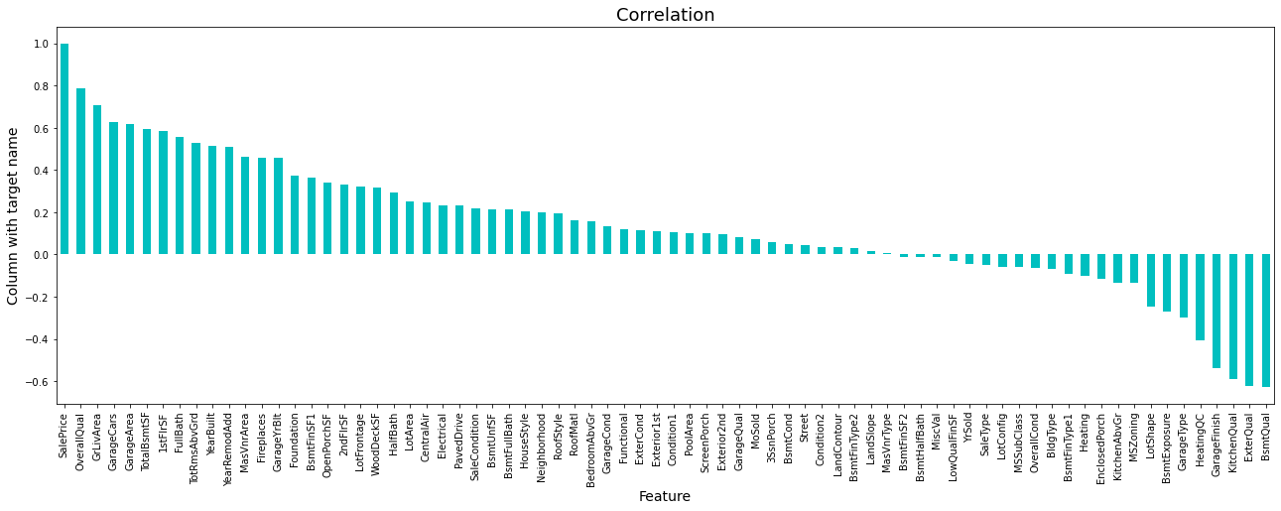

Slide 19
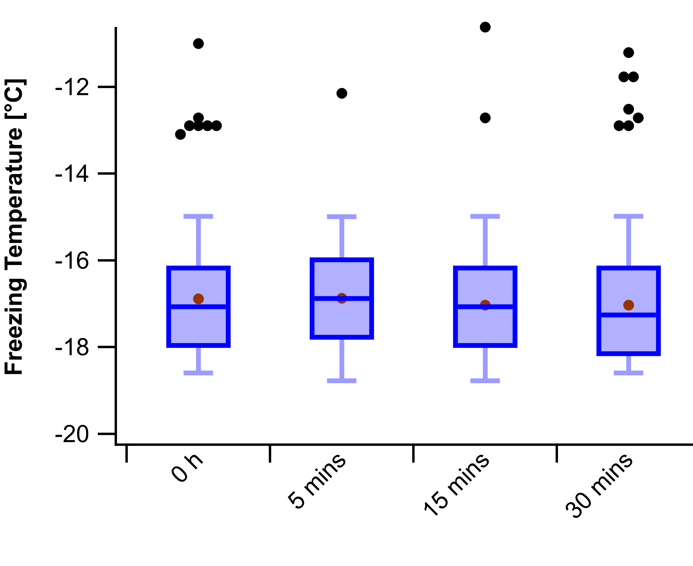
Remove outliers
For remove outlier we use Boxplot to check there are outliers are there or not.
We checked each numerical columns by boxplot and we observe that there are many columns are contains to much outliers we dropped that columns.
And then we use zscore and IQR method to remove outliers we observe that 50% and 89% drop respectively so we skip to remove all outliers.

Slide 20
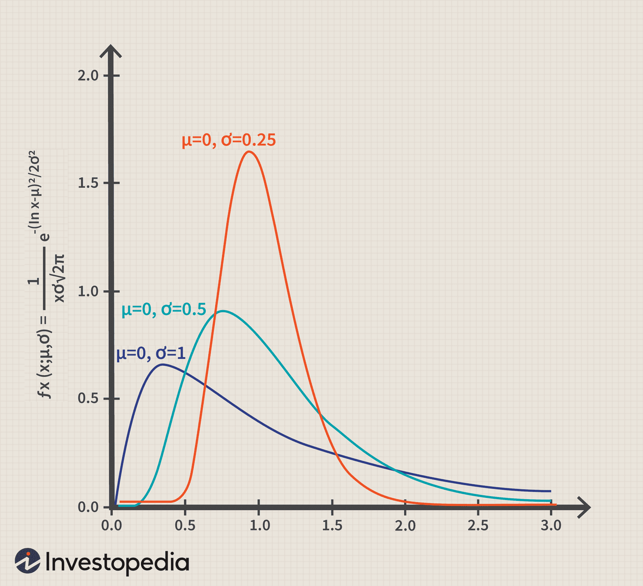
Skewness remove
For remove skewness in each numerical column we use boxcox, sqrt, log and yeojohnson.
By use of all these four method we created one function and check skewness and which one is give best result from above four we are going with it.

Slide 21

Machine Learning
We observe that our data is in continuous form so we will use regression algorithm.
In Regression algorithm there are many model are available.
We first find best random state and we split our data accordingly.
Our data is split now we apply all the regression and check error and r2_score and we final one algorithm and we save it.

Slide 22
Compare All model
Model | R2_score | CV | Cross_val_score | MAE | MSE | RMSE
Linear | 82.10 | 8 | 76.94 | 19901 | 1106678018 | 33266
GBR | 89.12 | 3 | 87.84 | 15980 | 668256074 | 25850
ADA | 82.16 | 3 | 80.13 | 23668 | 1103198833 | 33214
RFR | 87.46 | 3 | 85.26 | 17178 | 775884381 | 27854
SVR | - | - | - | - | - | -
DTR | 75.94 | 6 | 73.60 | 26744 | 147963944 | 38574
KNN | 69.32 | 3 | 68.98 | 28349 | 1897678415 | 43562
As we observe in above compare table, we observe that in GBR we get high accuracy and low error as compare to others. so, we apply hyper parameters on GBR method.

Slide 23
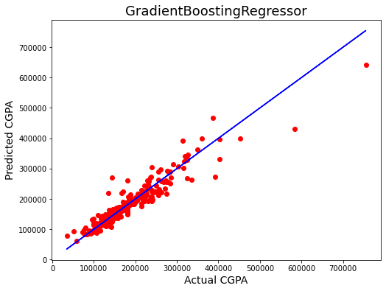
Plot actual result and pred. result graph

Slide 24

Saved model
By use of save model we predict out test data and join it with Data Frame.

Slide 25
Thank you

